Slide 1
Discussion 7
Growth, Exam Prep
Jason Zhou | Section 136
CS61A Spring 2019

Slide 2
Announcements
Lab07: Today
Lab cancelled next week
HW06: Today
Midterm 2: Tuesday 3/19 8-10PM

Slide 3
Agenda
Misc. Questions
OOG/Growth
Exam Review
Recursion/Tree Recursion
Trees
OOG (Growth)
Linked Lists, Python Lists/LC
OOP
Nonlocal

Slide 4
Misc. Questions
Dictionary
d = {“a” : 1, “b”: 2, “c” : 3}
Table with two columns: key, value
Each key can only appear once
(But values can be non-unique)
Add new key, value pair to dictionary d:
d[new_key] = new_value
Change old key’s value:
d[old_key] = new_value
Check if key in dictionary:
if key in d
Extremely fast look up
Key | Value
“a” | 1
“b” | 2
“c” | 3

Slide 5
Misc. Questions
__str__ vs. __repr__
Point 1: Interpreter vs. Python Files
Python Interpreter (“>>>”) evaluates then displays the value of expressions
>>> 3 + 2
5
Compare:
Python file with “3 + 2”: nothing is displayed unless print() is used

Slide 6
Misc. Questions
__str__ vs. __repr__
Point 2:
What happens when the interpreter is given an object to display:
>>> fido = Dog()
>>> fido
Python Interpreter display procedure:
print(repr(fido))
Point 3:
When print is used on an object:
print(fido)
if __str__ exists for class, then: print(str(fido))
else: print(repr(fido))

Slide 7
Misc. Questions
Trees vs. Tree Recursion
Trees:
Recursive data type (i.e. a tree is made up of smaller trees)
Two implementations: Tree ADT, Tree Class
Tree ADT: building a tree using normal python functions (i.e. def tree())
Tree Class: building a tree using python classes (i.e. class Tree)
Tree Recursion:
Making more than 1 recursive call in a recursive function

Slide 8
OOG
Efficiency
Definition: Input size vs. runtime
Response of runtime to an increase in input size
Asymptotic response
Runtime when input size approaches infinity
Ignores small differences in computing hardware, randomness, etc.
Theta notation 𝛳:
A program r(n) runs in f(n) time.
r(n) = 𝛳(f(n))

Slide 9
OOG
def foo(n):
return n
Runtime independent of input size
Simply return the value given
Constant time
foo(n) = 𝛳(1)
def foo(n):
print(n)
print(n)
return n

Slide 10
OOG
def foo(n):
for i in range(n):
print(i)
Runtime is dependent on input size
Bigger n, more iterations of for loop
For loop runs for n iterations
Inside each iteration, we do constant work
Linear time
foo(n) = 𝛳(n)

Slide 11
OOG
def foo(n):
for i in range(n):
for j in range(n):
print(j)
Runtime is dependent on input size
Bigger n, many more iterations of for loop
First for loop runs for n iterations
Inside each iteration, we have a for loop
Second for loop runs for n iterations
Quadratic time
foo(n) = 𝛳(n²)

Slide 12
OOG: Complexity Classes
𝛳(1)
Constant
𝛳(log(n))
Logarithmic
𝛳(nlog(n)): Linearithmic
𝛳(n²)
Quadratic
𝛳(n^{b})
Polynomial
𝛳(b^{n})
Exponential
𝛳(n!)
Factorial

Slide 13
OOG
Runtime Properties:
Constant terms do not affect runtime
𝛳(5n) = 𝛳(n)
Base of logarithm does not affect runtime
𝛳(log₄(n)) = 𝛳(log(n))
Fastest growing part dominates total runtime
𝛳(2n + 0.5n³) = 𝛳(n + n³) = 𝛳(n³)

Slide 14
OOG
A program r(n) runs in f(n) time.
r(n) = 𝛳(f(n))
True if there exists positive constants c, k, q such that for n >= q:
c*f(n) <= r(n) <= k*f(n)
foo(n) = 2n = 𝛳(n)
True
Exists positive constants 1, 3, 0 such that for n >= 0, 1*n <= 2n <= 3*n
k*f(n)
r(n)
c*f(n)
n
q

Slide 15
def moo(n):
result = 0
while n > 1:
n = n // 2
result += 1
return result
𝛳(log(n))

Slide 16
def boo(n):
if n == 0:
return 1
return boo(n - 1) + boo(n - 1)
𝛳(2^{n})

Slide 17
n
n - 1
n - 1
n - 2
n - 2
n - 2
n - 2
...
𝛳(2^{n})

Slide 18
def fib(n):
if n == 0 or n == 1:
return n
return fib(n-1) + fib(n-2)
def fib(n):
cur, next = 0, 1
while n > 0:
cur, next = next, cur + next
n -= 1
return cur
𝛳(2^{n}) 𝛳(n)
Why?
Memoization: Store the result of previous calculations

Slide 19
fib_d = {}
def fib(n):
if n == 0 or n == 1:
return n
elif n in fib_d:
return fib_d[n]
else:
current = fib_d[n-1] if (n-1) in fib_d else fib(n-1)
prev = fib_d[n-2] if (n-2) in fib_d else fib(n-2)
fib_d[n] = current + prev
return current + prev

Slide 20
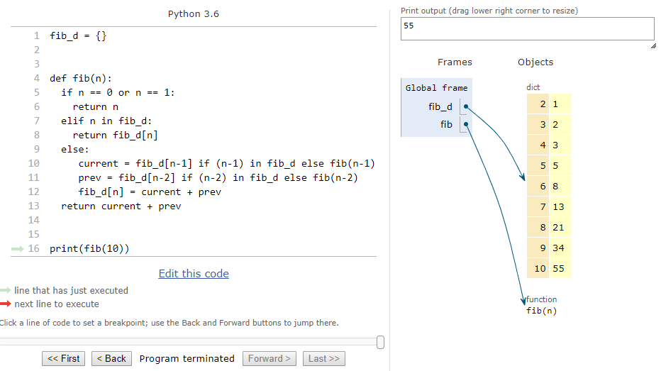

Slide 21
Exam Review
Recursion/Tree Recursion/Trees
3.4
OOG (Growth)
2.1 - 2.4
Linked Lists, Python Lists
1.1, 1.2, 3.2

Slide 22
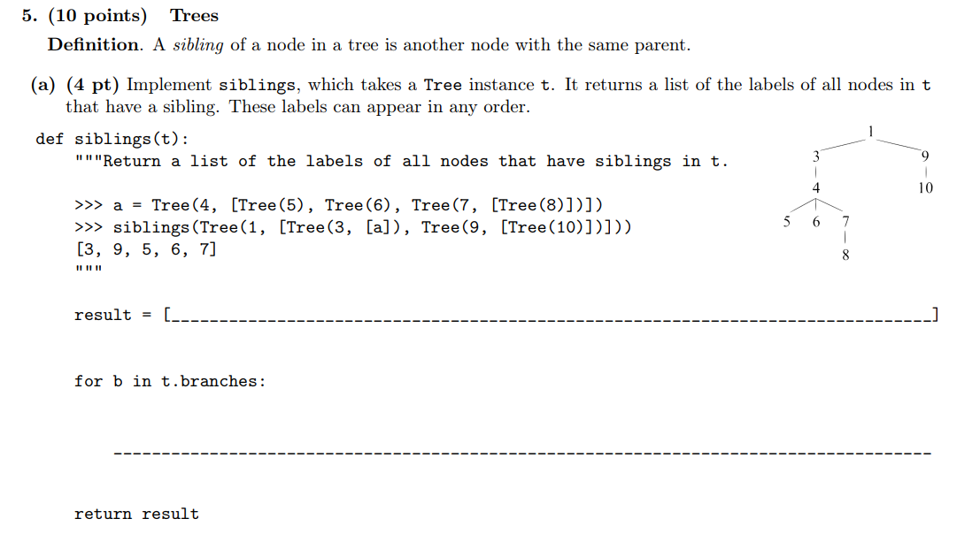
5

Slide 23
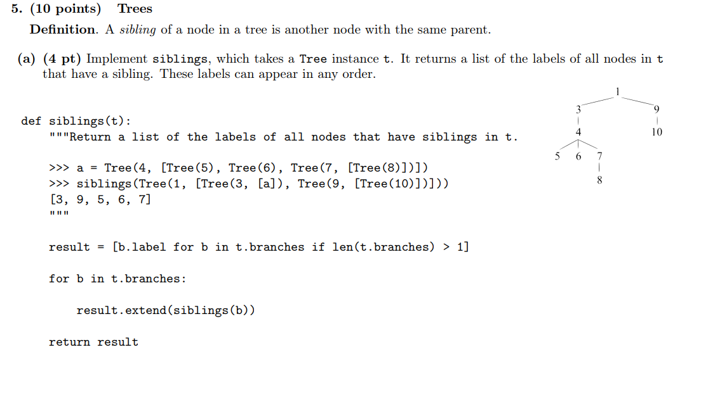

Slide 24
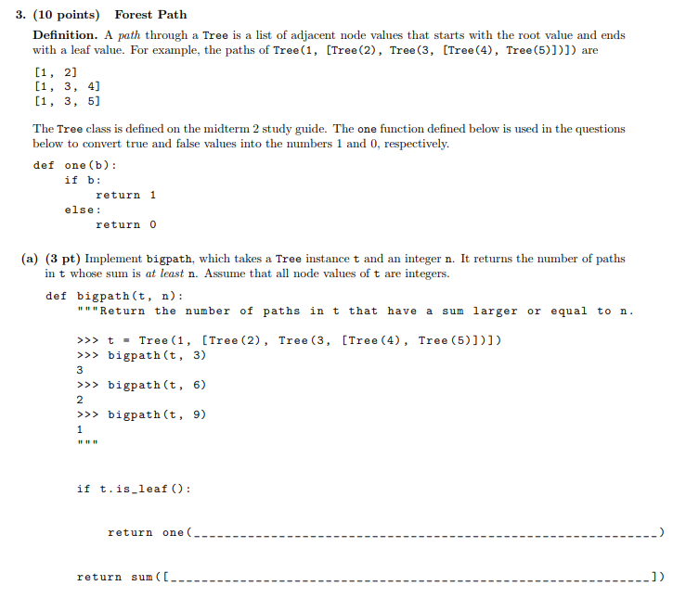
2

Slide 25
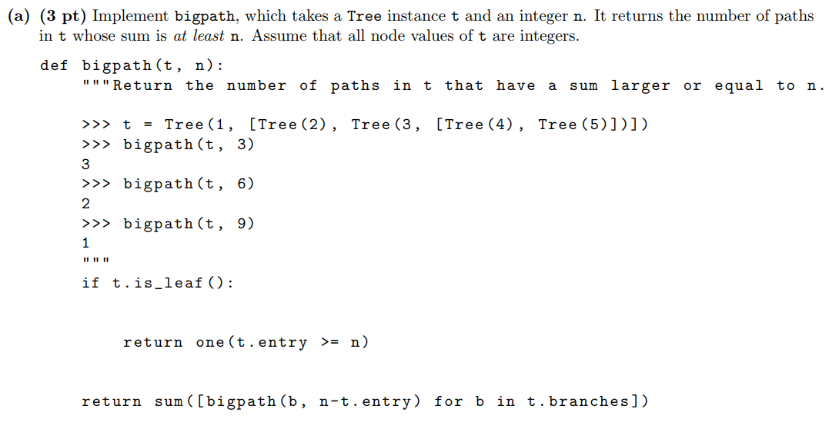

Slide 26
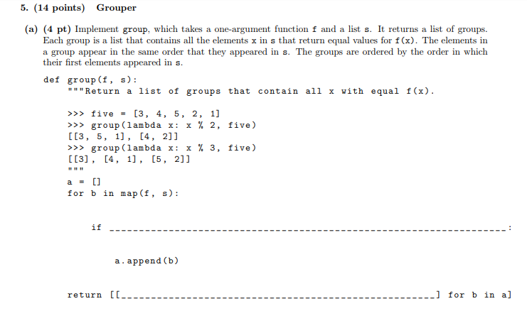
7

Slide 27
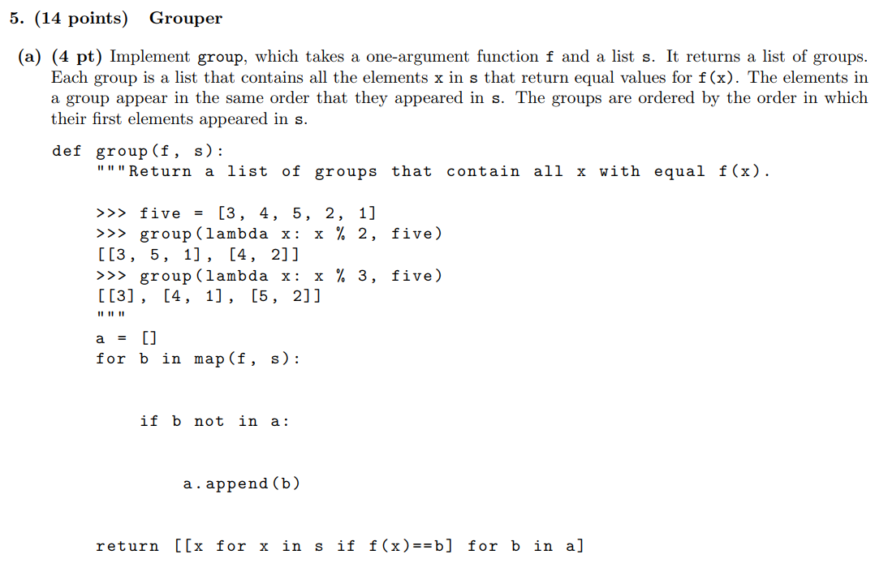

Slide 28
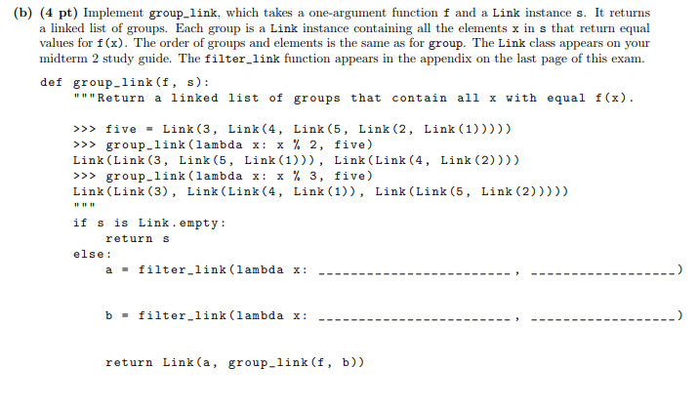
8

Slide 29
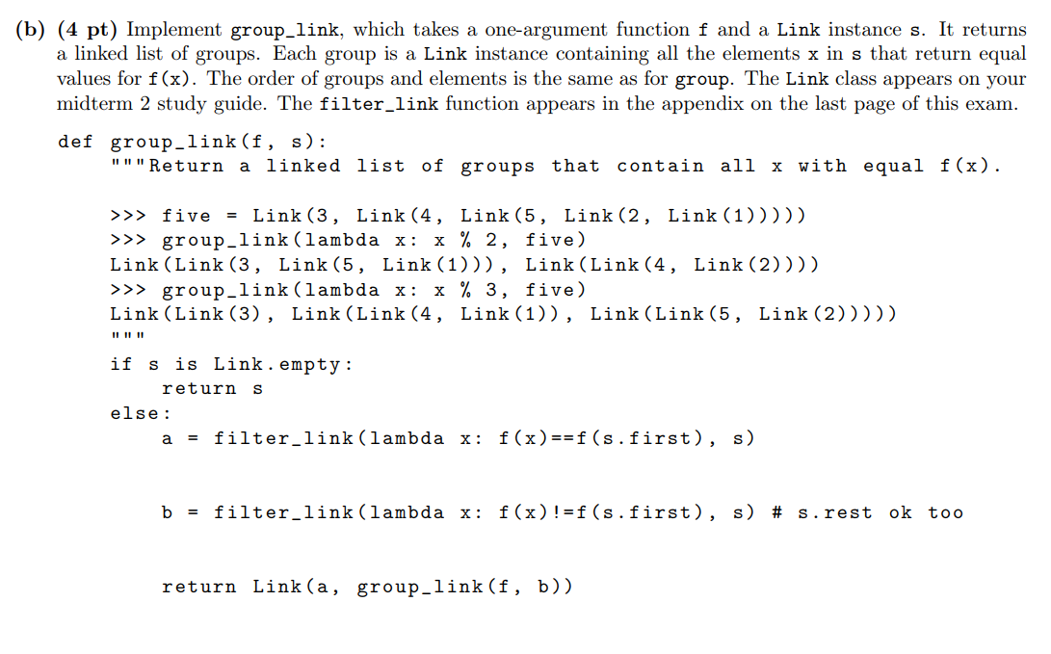

Slide 30
Attendance
links.cs61a.org/jasonz-attendance

Slide 31
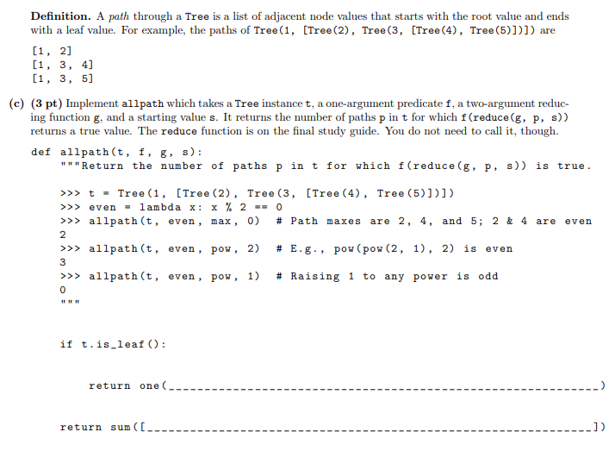
3

Slide 32
